Slide 1

Università degli Studi di Perugia
Facoltà di Ingegneria
Dottorato in Ingegneria Civile e Materiali Innovativi
XXV Ciclo – ICAR 09
Anno Accademico 2011/2012
Approccio Energetico per la Valutazione
della Risposta Sismica delle Strutture
Mediante la Analisi Statica Non Lineare
Candidato:
dott. ing. Enrico Tomassoli
Relatore:
prof. Marco Mezzi
Coordinatore:
prof. Claudio Tamagnini

Slide 2
Introduction
Energy-Based Approach
Introduction
At first, this concept had been proposed by Housner (1956) and Bertero, al. (1988) provided its mathematical formulation using by the Energy-Balance Equation
Pushover Analysis
Structural Response
Input Energy
(E_{I})
Seismic Demand
Absorbed Energy
(E_{a})
Dissipated Energy
(E_{d})
Non Linear Procedures
Spring En.
(E_{s})
Kinetic En.
(E_{k})
Damping En.
(E_{ξ})
Hysteretic En.
(E_{h})
SDOF
Systems
2D-MDOF Systems
Obtained through the integration of the equation of motion
3D-MDOF Systems
Conclusions

Slide 3
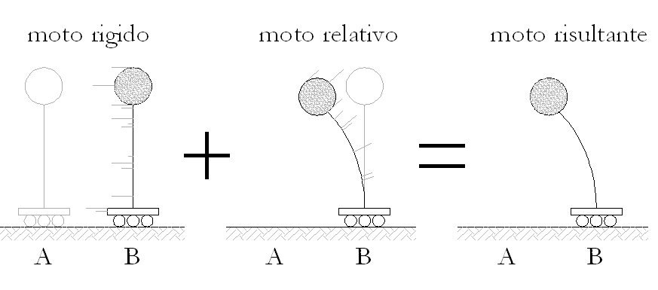
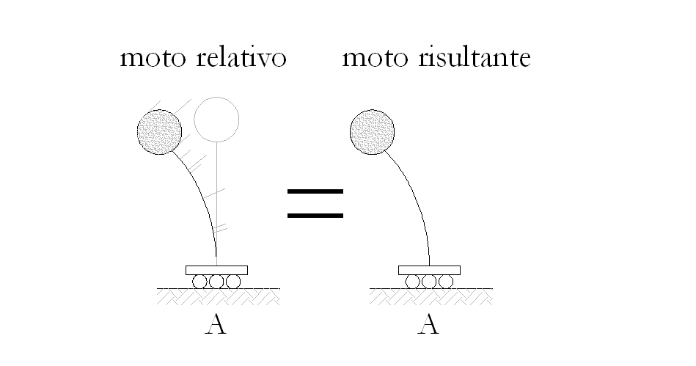
Introduction
Energy-Balance Equation
Introduction
The integration can be done in two ways:
Pushover Analysis
Energy-Balance Equation (absolute terms):
Structural Response
Seismic Demand
Energy-Balance Equation (relative terms):
Non Linear Procedures
SDOF
Systems
2D-MDOF Systems
3D-MDOF Systems
Conclusions
(absolute)
(relative)

Slide 4
Introduction
Energy-Balance Equation
Introduction
The difference between an absolute and relative approach is
Pushover Analysis
(Absolute)
(Relative)
Structural Response
Seismic Demand
The difference is represented by the kinetic energy due to the motion of ground
Non Linear Procedures
This difference increases for low and high values of period
For mid-values of period this difference is negligible
SDOF
Systems
2D-MDOF Systems
3D-MDOF Systems
Conclusions

Slide 5
Introduction
Energy-Balance Equation for Non Linear Static Analysis
Introduction
Since Non Linear Static Analysis (NLSA) has been adopted, both energy-balance equations converge to the same form:
Pushover Analysis
Structural Response
(Absolute)
(Relative)
Seismic Demand
Non Linear Procedures
because Kinetic (E_{k}) and Damping (E_{ξ}) Energies depend on velocity (dx/dt) that is null in a static analysis
SDOF
Systems
Eventually, Absolute/Relative Input Energy is equal to absorbed energy composed by both spring (elastic) and hysteretic (inelastic) contributions
2D-MDOF Systems
3D-MDOF Systems
Conclusions

Slide 6
Introduction
Pseudo-Energy parameter
Introduction
In NLSA, the Input Energy is represented by the area enclosed by the pushover curve (force-displacement plane)
Pushover Analysis
Structural Response
Force
Input
Energy
The energy-based concept can be proficiently utilized in Non Linear Static Analysis
Seismic Demand
Non Linear Procedures
Displacement
SDOF
Systems
Input Energy
(E_{I})
2D-MDOF Systems
Absorbed Energy
(E_{a})
Dissipated Energy
(E_{d})
3D-MDOF Systems
Spring En.
(E_{s})
Kinetic En.
(E_{k})
Damping En.
(E_{ξ})
Hysteretic En.
(E_{h})
Conclusions

Slide 7
Pushover Analysis Method
Non Linear Static Analysis procedure
Introduction
Pushover Analysis
Non Linear Static Analysis (Pushover)
Structural Response
Seismic Demand
Non Linear Procedures
SDOF
Systems
2D-MDOF Systems
3D-MDOF Systems
Conclusions

Slide 8
Pushover Analysis Method
Non Linear Static Analysis procedure
Introduction
Non Linear Static Analysis (NLSA) or Pushover is an useful tool to investigate non linear response of structural systems
Pushover Analysis
Several methodologies are provided by literature and seismic codes:
N2 Method (Eurocode 8, OPCM 3274, NTC 08)
CMDM (FEMA 356)
CSM (ATC-40)
CMDM, CSM (FEMA 440)
Structural Response
Seismic Demand
Non Linear Procedures
Structural
Response
Seismic
Demand
SDOF
Systems
2D-MDOF Systems
Non Linear
Procedure
3D-MDOF Systems
Seismic Performance
Conclusions

Slide 9
Pushover Analysis Method
Non Linear Static Analysis procedure
Introduction
Pushover procedure is characterized by critical steps when it is utilized to evaluate seismic response of structures
Pushover Analysis
Typically, issues related to this type of analysis are:
Problematic since dynamics behaviors are represented by means of static equivalent response
Definition of a unique point of system in order to represent entire structure response
Equipollence between real MDOF system and equivalent SDOF one
Comparison between seismic demand and structural capacity
Lateral force distribution used to represent seismic effects on structural masses
Fraction of total mass which participates to seismic response
Structural Response
Seismic Demand
Non Linear Procedures
SDOF
Systems
2D-MDOF Systems
3D-MDOF Systems
The procedures here proposed tent to overcome the difficulties and uncertainness mentioned above
Conclusions

Slide 10
Structural Response
Lateral Force Distribution
Introduction
Pushover Analysis
Structural Response
Structural Response of System
Seismic Demand
Non Linear Procedures
SDOF
Systems
2D-MDOF Systems
3D-MDOF Systems
Conclusions

Slide 11
Structural Response
Lateral Force Distribution
Introduction
Since a reliable numeric model of system has been defined, a Lateral Force Distribution (LFD) must be applied to the structure to represent the effect of seismic excitation
Pushover Analysis
Structural Response
In this study, four (4) different configurations are considered:
Seismic Demand
Non Linear Procedures
SDOF
Systems
Mod
Uni
Ada
Mul
2D-MDOF Systems
3D-MDOF Systems
Conclusions

Slide 12
Structural Response
Energy-Based Structural Response
Introduction
Knowledge of displacements, storey drifts, applied lateral forces and base shear is available since NL analysis has been performed
Pushover Analysis
An energy-representation of structural response can be provided by means of processing information mentioned above
Structural Response
Seismic Demand
Non Linear Procedures
SDOF
Systems
2D-MDOF Systems
3D-MDOF Systems
Conclusions

Slide 13
Structural Response
Same-Energy Displacement
Introduction
Through the use of last formula, the work done by lateral forces applied to the system (or energy absorbed) is known at each step
Pushover Analysis
An incremental parameter can be introduced, defined by the ratio of incremental work done and base shear at k^{th} step
Structural Response
Continuous
System
Seismic Demand
Non Linear Procedures
Discrete System
SDOF
Systems
2D-MDOF Systems
The sum of each Δu_{e}^{(k)} allows to know, at p^{th} step, the value of
3D-MDOF Systems
Same-Energy Displacement
(equivalent SDOF)
Conclusions

Slide 14
Structural Response
Energy-Based Structural Response
Introduction
The introduction of this parameter allows to achieve several benefits for what concerns Non Linear Static Analysis:
Pushover Analysis
Arbitrary choice of control point (rooftop CM) is avoided
Univocal displacement for entire system is defined
Parameter provides a direct relationship between seismic excitation (represented by lateral forces) and structural response (represented by storey displacements)
An immediate equivalence in terms of energy is obtained between MDOF and SDOF systems
Structural Response
Seismic Demand
Non Linear Procedures
SDOF
Systems
2D-MDOF Systems
3D-MDOF Systems
Conclusions

Slide 15
Seismic Demand
Energy-Based Seismic Demand
Introduction
Pushover Analysis
Structural Response
Seismic Demand
Energy-Based Seismic Demand
Non Linear Procedures
SDOF
Systems
2D-MDOF Systems
3D-MDOF Systems
Conclusions

Slide 16
Seismic Demand
Energy-Based Seismic Demand
Introduction
In order to represent an energy-based seismic input consistent with the response evaluated using by Non Linear Static Analysis, a parameter here called Pseudo-Energy has been introduced
Pushover Analysis
Structural Response
Seismic Demand
Structural Capacity
Seismic Demand
RHA
Non Linear Procedures
Force
SDOF
Systems
2D-MDOF Systems
Providing Demand and Capacity in this energy format, RHA and NLSA responses are congruent
Displacement
3D-MDOF Systems
Dynamic response
Conclusions
Envelope curve

Slide 17
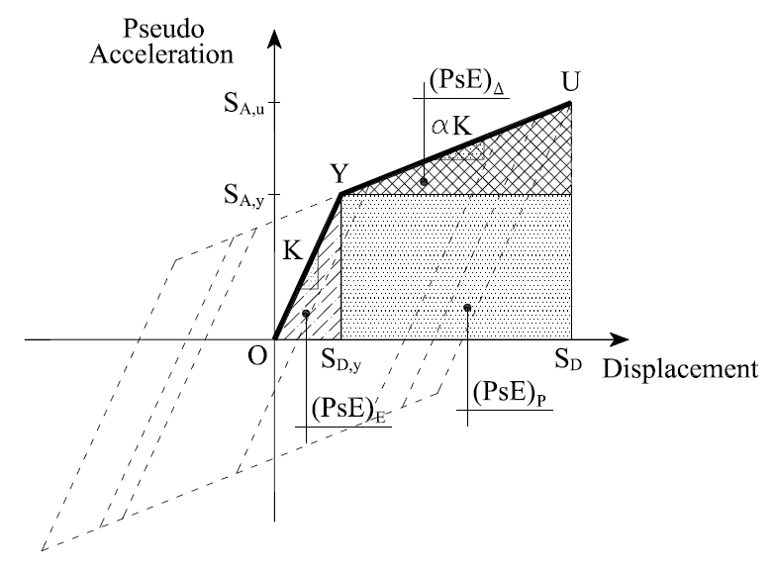
Seismic Demand
Pseudo-Energy Parameter
Introduction
Starting from spectral displacement (S_{D}) and pseudo-acceleration (S_{A}), when period (T), ductility (μ) and hardening factor (α) are known, Pseudo-Energy (PsE) can be computed as
Pushover Analysis
Structural Response
Seismic Demand
Non Linear Procedures
This relationship is valid, in general, for ESH systems
Elastic behavior μ = 1.0
For EPP systems α= 0.0
SDOF
Systems
2D-MDOF Systems
3D-MDOF Systems
Conclusions

Slide 18
Seismic Demand
Pseudo-Energy Spectra
Introduction
Using the definition of Pseudo-energy (PsE), the seismic spectra can be defined to represent seismic input in a NLS procedures
Pushover Analysis
In this study, three (3) different approaches have been considered with this aim:
Direct method: a large number of accelerograms is considered in order to calculate demand spectra
Indirect method: starting from elastic spectra provided by codes, inelastic spectra are computed utilizing modification factors proposed in literature
Semi-direct method: a restricted numbers of accelerograms is take into account to calculate inelastic demand spectra
Structural Response
Seismic Demand
Non Linear Procedures
SDOF
Systems
2D-MDOF Systems
3D-MDOF Systems
Conclusions

Slide 19
Seismic Demand
Energy Spectra - Direct Method
Introduction
Direct Method:
Pushover Analysis
A number as large as possible of accelerograms should be taken into account to create a database where time histories can be selected
Structural Response
Each recorded or simulated (not generated) accelerogram should be characterized by most important seismic parameters
Seismic Demand
Non Linear Procedures
Since the range of each parameter has been defined, a group of accelerograms can be selected and relative spectra can be computed
SDOF
Systems
Paper:
Tomassoli, Mezzi - “Energy-Based Criterion for the Evaluation of Seismic Input Spectra for Non Linear Static Analyses”
14th ECEE, 2010
2D-MDOF Systems
3D-MDOF Systems
Conclusions

Slide 20
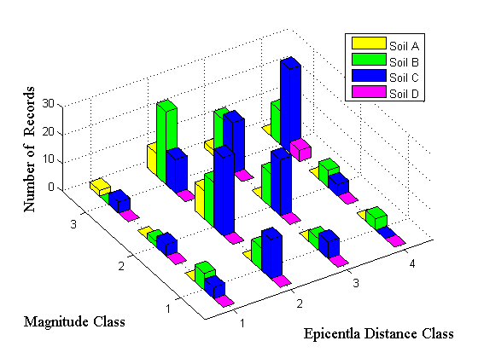
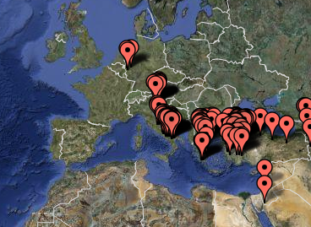
Seismic Demand
Energy Spectra - Direct Method
Introduction
An application of this method is also reported in Appendix B
Pushover Analysis
A set of 149 accelerograms correspondents to 32 events occurred in Mediterranean area has been selected from the NGA-PEER database
Structural Response
Accelerograms categorized by:
Soil Type (V_{S30})
Epicentral Distance (D)
Magnitude (M)
Seismic Demand
Non Linear Procedures
SDOF
Systems
2D-MDOF Systems
Spectral SDOF models utilized:
ESH (α = 0%, 15%, 30%)
Ductility values (μ= 1, 2, 4, 6)
3D-MDOF Systems
Conclusions

Slide 21
Seismic Demand
Energy Spectra - Direct Method
Introduction
The influence of these parameters on seismic demand spectra, proposed in terms of pseudo-energy, has been investigated
Pushover Analysis
Structural Response
Seismic Demand
Hysteretic Model
Ductility Value
Non Linear Procedures
SDOF
Systems
2D-MDOF Systems
Type of Soil
Magnitude
3D-MDOF Systems
Conclusions

Slide 22
Seismic Demand
Energy Spectra - Indirect Method
Introduction
Indirect Method:
Pushover Analysis
Starting from elastic seismic demand spectra in terms of displacement and pseudo-acceleration, and using by appropriated modification factors present in literature, inelastic ps-energy spectra can be determined
Structural Response
Seismic Demand
This approach is very useful for practical purposes when elastic spectra provided by codes are chosen
Non Linear Procedures
Anyway, reliable modification factors are needed to move from elastic to inelastic representation of spectra
SDOF
Systems
An exhaustive explanation of this procedure is reported in Appendix A of the dissertation
2D-MDOF Systems
3D-MDOF Systems
Conclusions

Slide 23
Seismic Demand
Energy Spectra - Indirect Method
Introduction
Steps to do in order to provide inelastic pseudo-energy spectrum are
Pushover Analysis
Displacement, S_{D}
Ps-acceleration, S_{A}
μ = 1
μ = μ₀
Structural Response
μ = 1
Seismic Demand
μ = μ₀
Period, T
Period, T
Non Linear Procedures
Displacement Modifications Factors (R_{δ})
(Miranda)
Strength Reduction Factors (R)
(Newmark – Hall)
SDOF
Systems
Ps-energy, PsE
μ = 1
2D-MDOF Systems
μ = μ₀
3D-MDOF Systems
Conclusions
Period, T

Slide 24
Seismic Demand
Energy Spectra - Indirect Method
Introduction
Examples of spectra, according to Eurocode 8, for a soil B and valued of ductility of μ = 1, 2, 4, 6, are reported below
Pushover Analysis
Structural Response
Seismic Demand
Non Linear Procedures
SDOF
Systems
2D-MDOF Systems
3D-MDOF Systems
Conclusions

Slide 25
Seismic Demand
Energy Spectra - Semi-direct Method
Introduction
Semi-direct Method:
Pushover Analysis
This method takes into consideration both approaches (direct and indirect) previously proposed
Structural Response
This approach is also very useful for practical purposes since elastic/inelastic reference spectrum, provided by codes, is considered
Seismic Demand
The procedure is based, in general, on the following steps:
Define a reference spectrum in terms of a specific parameter (S_{D,e}, S_{D,μ} , S_{A,e}, S_{A,μ}, PsE_{e}, PsE_{e})
Select a group of accelerograms characterized by scattering between mean spectrum and reference one as lower as possible
Calculate, for each accelerogram, its spectra in terms of displacement and pseudo-acceleration (elastic/inelastic)
Calculate, for each accelerogram, its pseudo-energy spectra
Compute the mean spectra in terms of pseudo-energy
Non Linear Procedures
SDOF
Systems
2D-MDOF Systems
3D-MDOF Systems
Conclusions

Slide 26
Seismic Demand
Energy Spectra - Semi-direct Method
Introduction
The selection of recorded accelerograms characterized by a mean spectrum which matches the reference one represents the critical passage when a reliable seismic input for NLSA is required
Pushover Analysis
Structural Response
Paper:
Tomassoli, Mezzi - “Energy-based Criterion for the Selection of the Seismic Input for Inelastic Dynamic Analyses”
9th US Nat. and 10th Canadian Conf. on Earthquake Eng., 2010
Seismic Demand
Non Linear Procedures
SDOF
Systems
An alternative solution is represented by adopting generated/simulated accelerograms, still characterized by a mean spectrum in accordance with the reference one
2D-MDOF Systems
3D-MDOF Systems
Conclusions

Slide 27
Seismic Demand
Energy Spectra - Semi-direct Method
Introduction
It has been assumed a group of accelerograms where selection procedure was based on an elastic ps-acceleration criterion
Pushover Analysis
Structural Response
A set of 7 recorded accelerograms, selected from NGA PEER database, has been considered to calculate input pseudo-energy
Seismic Demand
Non Linear Procedures
SDOF
Systems
2D-MDOF Systems
3D-MDOF Systems
Conclusions

Slide 28
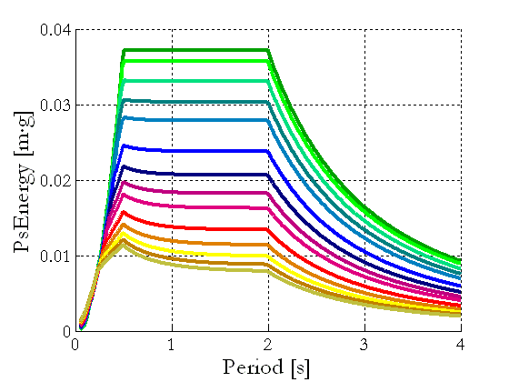
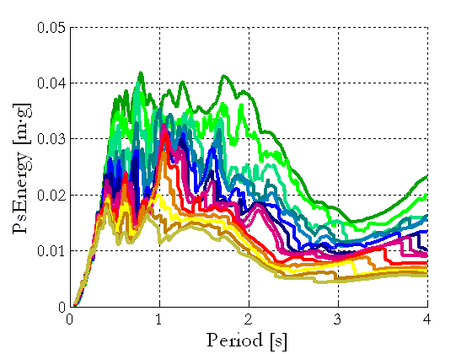
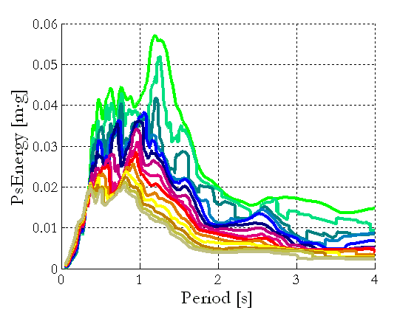
Seismic Demand
Energy Spectra
Introduction
The following scenarios are considered in order to define seismic input spectra to be used in NLSA
Pushover Analysis
Code Spectra (CodSpe):
Indirect approach has been used, adopting Newmark-Hall and Miranda modification factors [GenAcc, RecAcc]
Structural Response
Seismic Demand
Non Linear Procedures
Generated Spectra (GenSpe):
Semi-direct approach has been used, adopting elastic ps-acceleration criterion to generate accelerograms [GenAcc]
SDOF
Systems
2D-MDOF Systems
Recorded Spectra (RecSpe):
Semi-direct approach has been used, adopting elastic ps-acceleration criterion to select accelerograms [RecAcc]
3D-MDOF Systems
Conclusions

Slide 29
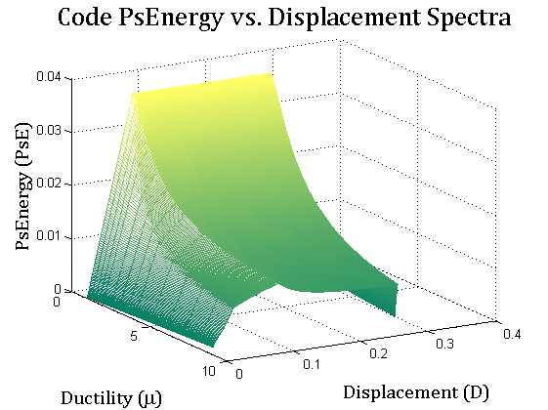
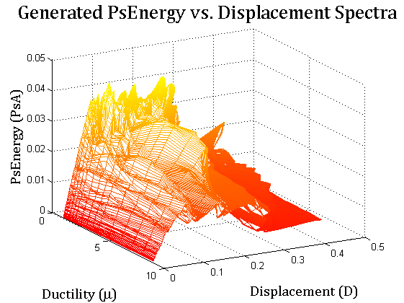
Seismic Demand
Energy Spectra
Introduction
An useful representation of seismic demand is to report ps-energy parameter in (3D) form of Energy–Displacement–Ductility Response Spectrum (EDμRS)
Pushover Analysis
Structural Response
Seismic Demand
Non Linear Procedures
SDOF
Systems
2D-MDOF Systems
3D-MDOF Systems
Code Spectra
Generated Spectra
Conclusions

Slide 30
Non Linear Procedure
Non Linear Static Procedure and Performance Point
Introduction
Pushover Analysis
Structural Response
Seismic Demand
Non Linear Static Procedures
to Determine Seismic Performance
Non Linear Procedures
SDOF
Systems
2D-MDOF Systems
3D-MDOF Systems
Conclusions

Slide 31
Non Linear Procedure
Non Linear Static Procedure and Performance Point
Introduction
Since both system capacity and seismic demand are defined, a procedure to compare them is required in order to evaluate the performance of structure
Pushover Analysis
Structural Response
As a benchmark, N2-Method proposed by Eurocode (EC8-N2) is adopted
Seismic Demand
The Energy-Based NLSA estimates the performance point providing two different approaches or procedures
Non Linear Procedures
Procedure Energy-A:
Through the use of its bi-linearization, the energy capacity curve intersects spectral surface in the performance point
Procedure Energy-B:
The performance point is reached by means of a preliminary elastic pushover
SDOF
Systems
2D-MDOF Systems
3D-MDOF Systems
Conclusions

Slide 32
Non Linear Procedure
Non Linear Static Procedure and Performance Point
Introduction
In Energy-Based Procedures, in order to make capacity curve consistent with spectral surface, a value of Effective Seismic Mass must be chosen
Pushover Analysis
Structural Response
The following values of effective mass have been considered:
Equivalent first mode mass* (Ec8):
Seismic Demand
Non Linear Procedures
First mode mass (modal analysis):
SDOF
Systems
2D-MDOF Systems
Total mass:
3D-MDOF Systems
Conclusions

Slide 33
Non Linear Procedure
Non Linear Static Procedure and Performance Point
Introduction
Procedure Energy-A:
This procedure is base on bi-linearization of capacity curve with the aim of knowing μ-value at each step of pushover
Pushover Analysis
Structural Response
Ps-Energy
F_{b}
Yield Point (Y)
EDμRS
Seismic Demand
F_{Y}
Max Displacement Point (U)
Non Linear Procedures
Equal area (W)
Displacement
SDOF
Systems
O
u_{Y}
u_{U}
u
Ductility
2D-MDOF Systems
At each step of NLSA, values of same-energy displacement (u), pseudo-energy (w), and ductility (μ) are known
3D-MDOF Systems
Energy Capacity Curve can be plotted in EDμRS (3D) and its intersection with spectral surface represents the performance point
Conclusions

Slide 34
Non Linear Procedure
Non Linear Static Procedure and Performance Point
Introduction
Procedure Energy-A:
Pushover Analysis
Bi-linearization of capacity curve represents crucial step
(w, PsE)
Structural Response
Spectral Surface:
S = S {S_{D}, PsE, μ}
Seismic Demand
Capacity Curve:
C = C {u, w, μ}
C
Non Linear Procedures
μ₁
SDOF
Systems
P_{P}
μ₂
2D-MDOF Systems
μ₃
(u, S_{D})
3D-MDOF Systems
μ₄
(μ)
Conclusions

Slide 35
Non Linear Procedure
Non Linear Static Procedure and Performance Point
Introduction
Procedure Energy-B:
This procedure is base on a preliminary elastic pushover analysis (≈ linear static analysis) with the aim of knowing T-value when ductility μ = 1.0 (elastic case)
Pushover Analysis
Structural Response
Since elastic performance has been evaluated, the period T = T_{e} is defined
Seismic Demand
Non Linear Procedures
Moving from the elastic performance point, the intersection of constant-period curve and energy capacity curve represents the inelastic performance point
SDOF
Systems
2D-MDOF Systems
3D-MDOF Systems
Conclusions

Slide 36
Non Linear Procedure
Non Linear Static Procedure and Performance Point
Introduction
Procedure Energy-B:
Preliminary linear analysis is required to evaluate elastic performance
Pushover Analysis
(w, PsE)
C_{e}
Structural Response
Spectral Surface:
S = S {S_{D}, PsE, μ}
P_{E}
(T = T_{e})
Seismic Demand
Capacity Curve:
C_{e} = C {u, w, μ=1}
Non Linear Procedures
C = C {u, w, μ}
μ₁
SDOF
Systems
μ₂
2D-MDOF Systems
P_{P}
μ₃
(u, S_{D})
3D-MDOF Systems
μ₄
(μ)
Conclusions
C

Slide 37
Non Linear Procedure
Assessment of Reliability of NLS Methodologies
Introduction
Modeling of Structural System
Pushover Analysis
Non Linear Static Analysis (NLSA)
Response History Analysis (RHA)
Structural Response
Pushover Curve
(Mod, Uni, Ada, Mul)
Non Linear
Dynamic Analysis
Accelerograms
Seismic Demand
Procedures
(EC8-N2, En-A, En-B)
Statistic Processing
(Mean, Standard Dev.)
Spectra
Non Linear Procedures
NLSA Output
(Displ., Drift, B. Shear)
RHA Output
(Displ., Drift, B. Shear)
SDOF
Systems
Comparison of Results
2D-MDOF Systems
3D-MDOF Systems
Error Parameter
Conclusions

Slide 38
SDOF Systems
Procedures Assessment by means of SDOF systems
Introduction
Pushover Analysis
Structural Response
Seismic Demand
Non Linear Procedures
SDOF
Systems
Evaluation of SDOF System Response
2D-MDOF Systems
3D-MDOF Systems
Conclusions

Slide 39
SDOF Systems
Procedures Assessment by means of SDOF systems
Introduction
For the analysis of response of SDOF systems the following assumptions have been adopted:
Pushover Analysis
Two seismic scenarios:
Seismic Zone = I, II
Peak Gr. Accel., PGA = 0.35·g, 0.25·g
Soil Condition = B
Equivalent Damping, ξ = 5%
(Group of 9-generated acceler. each)
Structural Response
Seismic Demand
Non Linear Procedures
SDOF
Systems
Three groups of SDOFs:
A = {A1, A2, A3}, T_{A} = 0.33 s
B = {B1, …, B6 }, T_{B} = 0.50 s
C = {C1, …, C6 }, T_{C} = 1.00 s
2D-MDOF Systems
3D-MDOF Systems
Conclusions

Slide 40
SDOF Systems
Procedures Assessment by means of SDOF systems
Introduction
Since a SDOF system has been adopted, some simplifications can be achieved for what concerns the NLSA parameters
Pushover Analysis
Lateral Force Distr. = {Mod, Uni, Ada, Mul} ≈ {One force}
Structural Response
Effective Seismic Mass = {m*, m_{I}, m_{tot}} ≈ {m_{SDOF}}
Seismic Demand
Due to the properties of SDOF models, results obtained from both NLSA and RHA can be directly compared
Non Linear Procedures
The following parameters have been considered:
Maximum Displacement (u)
Yield Displacement (u_{Y})
Base Shear (Yield Force) (F_{b})
Period (T)
Ductility (μ)
Strength Reduction Factor (R)
SDOF
Systems
2D-MDOF Systems
3D-MDOF Systems
Conclusions

Slide 41
SDOF Systems
Procedures Assessment by means of SDOF systems
Introduction
ε-displacement: comparison between NLSAs and RHA in terms of maximum displacement u_{max} of system
Pushover Analysis
In general, energy-based methods provide a better solution in comparison with N2-EC8
This is true for cat. I. On the contrary, it is not so clear since Cat. II has been considered
This trend is recognizable for the higher values of T (0.5, 1.0 s) but not for the lower period (0.3 s)
Structural Response
Seismic Demand
Non Linear Procedures
Cat. II
SDOF
Systems
2D-MDOF Systems
3D-MDOF Systems
Conclusions
Cat. I

Slide 42
SDOF Systems
Procedures Assessment by means of SDOF systems
Introduction
R-μ values: comparison between NLSAs and RHA when couples strength reduction factor/ductility (R-μ) are considered
Pushover Analysis
The Energy-B procedure tends to be comparable with RHA results. On the contrary, N2-EC8 does not and its tendency is opposite
When R and μ increase, scattering with RHA increase as well
Structural Response
Cat. I
T = 0.30 s
Seismic Demand
Non Linear Procedures
SDOF
Systems
Cat. I
T = 0.50 s
Cat. I
T = 1.00 s
2D-MDOF Systems
3D-MDOF Systems
Conclusions

Slide 43
SDOF Systems
Procedures Assessment by means of SDOF systems
Introduction
ε-period: comparison between NLSAs and Modal Analysis in terms of period T of system
Pushover Analysis
Both N2-EC8 and Energy-A procedures are based on bi-linearization that gives
Structural Response
Seismic Demand
Non Linear Procedures
Cat. II
Energy-B gives T, in an indirect way, using by evaluation of elastic performance and consequently the error is slightly higher
All procedures provide in all cases an accurate estimation of period
SDOF
Systems
2D-MDOF Systems
3D-MDOF Systems
Conclusions
Cat. I

Slide 44
2D-MDOF Systems
Procedures Assessment by means of 2D-MDOF systems
Introduction
Pushover Analysis
Structural Response
Seismic Demand
Non Linear Procedures
SDOF
Systems
2D-MDOF Systems
Evaluation of 2D-MDOF System Response
3D-MDOF Systems
Conclusions

Slide 45
2D-MDOF Systems
Procedures Assessment by means of 2D-MDOF systems
Introduction
The following 2D-MDOF systems have been considered in order to assess the reliability of the energy-based NLSAs proposed
Pushover Analysis
Structural Response
Seismic Demand
Non Linear Procedures
SDOF
Systems
Model | # Floors | # Bays | m_{tot} (t) | m* (%) | m_{I} (%) | Period (s) | Γ Factor | Ductil. Class | Design R
Alfa | 3 | 2 | 83.4 | 66.5 | 85.3 | 0.462 | 1.282 | High | 5.85
Beta | 4 | 3 | 144.6 | 64.8 | 86.6 | 0.509 | 1.336 | High | 5.85
Gamma | 6 | 3 | 327.6 | 50.2 | 72.7 | 0.624 | 1.448 | High | 5.85
Delta | 10 | 3 | 602.9 | 48.7 | 71.8 | 1.064 | 1.476 | High | 5.85
Eps (+) | 4 | 3 | 160.9 | 68.8 | 86.4 | 0.500 | 1.257 | High | 5.85
Eps (–) | 4 | 3 | 160.9 | 68.8 | 86.4 | 0.500 | 1.257 | High | 5.85
2D-MDOF Systems
3D-MDOF Systems
Conclusions

Slide 46
2D-MDOF Systems
Procedures Assessment by means of 2D-MDOF systems
Introduction
For what concerns the seismic input, the following assumptions have been adopted to perform NLSA and RHA
Pushover Analysis
Seismic Demand Spectrum:
Seismic Zone = I
Peak Gr. Acceleration, PGA = 0.35·g
Soil Condition = B
Equivalent Damping, ξ = 5%
Structural Response
Seismic Demand
Non Linear Procedures
SDOF
Systems
Two 7-accelerograms groups:
Gen_Acc = {7-Generated Accel.}
Rec_Acc = {7-Recorded Accel.}
2D-MDOF Systems
3D-MDOF Systems
Conclusions

Slide 47
2D-MDOF Systems
Procedures Assessment by means of 2D-MDOF systems
Introduction
Since a 2D-MDOF system has been adopted, the following parameters, which characterize estimated solution, are considered
Pushover Analysis
Lateral Force Distr. = {Mod, Uni, Ada, Mul} [4 options]
Effective Seismic Mass = {m*, m_{I}, m_{tot}} [3 options]
Procedure = {N2-EC8, En-A, En-B} [1+2 options]
Seismic Spectra = {Cod_Spe, Gen_Spe, Rec_Spe} [3 options]
Group of Accelerograms = {Gen_Acc, Rec_Acc} [2 options]
Structural Response
Seismic Demand
Non Linear Procedures
SDOF
Systems
For each scenario (combination of cases), results obtained from
both NLSA and RHA are compared in terms of
Storey Displacement (s_{i})
Storey Drift (d_{i})
Base Shear (F_{b})
2D-MDOF Systems
3D-MDOF Systems
Conclusions

Slide 48
2D-MDOF Systems
Procedures Assessment by means of 2D-MDOF systems
Introduction
Cases available for what concerns NLSAs:
Pushover Analysis
When the energy-based methodologies have been taken into account, each NLSA is characterized by
Structural Response
Seismic Demand
Non Linear Procedures
SDOF
Systems
Since the N2-EC8 methodology, here considered as a benchmark, has been taken into account, each NLSA is characterized by
2D-MDOF Systems
3D-MDOF Systems
Conclusions

Slide 49
2D-MDOF Systems
Procedures Assessment by means of 2D-MDOF systems
Introduction
Cases available for what concerns RHAs:
Pushover Analysis
When the non linear dynamic analyses have been taken into account, each RHA is characterized by
Structural Response
Seismic Demand
Non Linear Procedures
SDOF
Systems
The RHA cases proposed above derive from the fact that seismic demand spectra and groups of accelerograms must be consistent
2D-MDOF Systems
3D-MDOF Systems
Total Scenarios = [(24+4)_{NLSA}] x [4_{RHA}] x [6_{Models}] = 672
Conclusions

Slide 50
2D-MDOF Systems
Procedures Assessment by means of 2D-MDOF systems
Introduction
At first, a “Relative Comparison” between responses are made
Pushover Analysis
Each seismic performance, estimated by means of NLSA, is characterized by N parameters
Structural Response
One at the time, (N-1) parameters are fixed and the results, when the N^{th} parameter varies, are considered
Seismic Demand
Example:
Model “Alfa”
Displacement Error ε (Table 8.3.1.III, page 88)
(N-1) fixed parameters are: effective mass, NL procedure
N^{th} parameter is Lateral Force distribution
Seismic scenario are four (4)
Cases available are 112 grouped in (4·7) 28 sub-scenarios
Non Linear Procedures
SDOF
Systems
2D-MDOF Systems
3D-MDOF Systems
Conclusions

Slide 51
2D-MDOF Systems
Procedures Assessment by means of 2D-MDOF systems
Introduction
Spect. | Accel. | LFD | m* |  |  | m_{I} |  | m_{tot}
 |  |  | N2 | EnA | EnB | EnA | EnB | EnA | EnB
Cod | Gen | Mod | 83.0 | 49.1 | 15.2 | 76.9 | 45.5 | 94.0 | 69.0
 |  | Uni | 75.0 | 44.0 | 3.7 | 72.6 | 30.5 | 97.9 | 52.1
 |  | Ada | 82.5 | 49.8 | 13.5 | 78.0 | 44.4 | 93.2 | 69.4
 |  | Mul | 73.1 | 48.3 | 12.2 | 77.0 | 41.5 | 93.2 | 65.1
 | Rec | Mod | 32.7 | 8.6 | 17.5 | 28.3 | 5.8 | 40.7 | 22.6
 |  | Uni | 27.4 | 5.6 | 24.8 | 25.6 | 6.0 | 43.9 | 11.0
 |  | Ada | 32.3 | 8.7 | 18.7 | 29.1 | 5.1 | 40.1 | 22.8
 |  | Mul | 25.6 | 7.6 | 19.2 | 28.4 | 2.9 | 40.2 | 19.8
Gen | Gen | Mod | 83.0 | 41.2 | 28.8 | 71.5 | 40.7 | 70.5 | 56.3
 |  | Uni | 75.0 | 28.5 | 11.4 | 61.3 | 52.9 | 81.7 | 63.5
 |  | Ada | 83.0 | 42.1 | 39.3 | 73.0 | 40.9 | 70.7 | 55.9
 |  | Mul | 73.1 | 27.9 | 28.9 | 60.7 | 52.8 | 67.5 | 48.8
Rec | Rec | Mod | 32.7 | 14.1 | 11.6 | 30.3 | 15.4 | 58.5 | 37.6
 |  | Uni | 27.4 | 9.4 | 17.3 | 35.3 | 11.2 | 48.9 | 21.3
 |  | Ada | 32.7 | 14.3 | 11.4 | 30.2 | 15.2 | 56.9 | 37.7
 |  | Mul | 25.6 | 13.9 | 4.9 | 28.5 | 12.4 | s.n.t. | 36.3
Pushover Analysis
Structural Response
Seismic Demand
1st
2nd
3rd
4th
5th
6th
7th
Non Linear Procedures
SDOF
Systems
Best solution (LFD):
0/7 Modal (0%)
5/7 Uniform (71%)
1/7 Adaptive (14%)
1/7 Multimodal (14%)
2D-MDOF Systems
3D-MDOF Systems
Conclusions

Slide 52
2D-MDOF Systems
Procedures Assessment by means of 2D-MDOF systems
Introduction
Lateral Force Distribution (LFD) – (28·6) 168 sub-scenarios:
Pushover Analysis
There is no clear trend, in terms of displacement or drift, that suggests to use one Lateral Force Distribution rather than another
Modal, Adaptive and/or Multimodal LFD seem to be more accurate to estimate displacement and/or storey drift
On the contrary, Uniform LFD seems to be more accurate to estimate base shear
Structural Response
Seismic Demand
Non Linear Procedures
SDOF
Systems
2D-MDOF Systems
3D-MDOF Systems
Conclusions

Slide 53
2D-MDOF Systems
Procedures Assessment by means of 2D-MDOF systems
Introduction
Effective Seismic Mass – (16·6) 96 sub-scenarios:
Pushover Analysis
The choice of effective mass regards only energy-based procedures, due to the fact that N2-EC8 considers always m* value
In terms of displacement and/or storey drift, results suggest to adopt equivalent first mode mass m* as effective seismic mass
The use of first mode mass m_{I} should be taken into account for Energy-B
The value of total mass m_{tot} is more reliable for evaluation of base shear
Structural Response
Seismic Demand
Non Linear Procedures
SDOF
Systems
2D-MDOF Systems
3D-MDOF Systems
Conclusions

Slide 54
2D-MDOF Systems
Procedures Assessment by means of 2D-MDOF systems
Introduction
Non Linear Procedure – (16·6) 96 sub-scenarios:
Pushover Analysis
Since the comparisons have been made in terms of displacement and/or storey drift, the energy-based methodologies represent a robust tool to estimate seismic response
In particular, the Energy-B procedure provides a more accurate solution than Energy-A
On the contrary, when base shear has been chooses as a comparison parameter, Energy-A appears to be more accurate than other two methods
Structural Response
Seismic Demand
Non Linear Procedures
SDOF
Systems
2D-MDOF Systems
3D-MDOF Systems
Conclusions

Slide 55
2D-MDOF Systems
Procedures Assessment by means of 2D-MDOF systems
Introduction
Secondly, an “Absolute Comparison” between responses are made
Pushover Analysis
Each seismic performance, estimated by means of NLSA, is characterized by N parameters
Structural Response
One at the time, the combinations of all N-parameters are considered in order to infer which one provides the best solution
Seismic Demand
Example:
Model “Alfa”
Displacement Error ε (Table 8.3.1.III, page 88)
Combination of all parameters is considered (LFD, procedure, mass)
Seismic scenario are four (4)
Cases available are 112 grouped in 4 sub-scenarios
Non Linear Procedures
SDOF
Systems
2D-MDOF Systems
3D-MDOF Systems
Conclusions

Slide 56
2D-MDOF Systems
Procedures Assessment by means of 2D-MDOF systems
Introduction
Spect. | Accel. | LFD | m* |  |  | m_{I} |  | m_{tot}
 |  |  | N2 | EnA | EnB | EnA | EnB | EnA | EnB
Cod | Gen | Mod | 83.0 | 49.1 | 15.2 | 76.9 | 45.5 | 94.0 | 69.0
 |  | Uni | 75.0 | 44.0 | 3.7 | 72.6 | 30.5 | 97.9 | 52.1
 |  | Ada | 82.5 | 49.8 | 13.5 | 78.0 | 44.4 | 93.2 | 69.4
 |  | Mul | 73.1 | 48.3 | 12.2 | 77.0 | 41.5 | 93.2 | 65.1
 | Rec | Mod | 32.7 | 8.6 | 17.5 | 28.3 | 5.8 | 40.7 | 22.6
 |  | Uni | 27.4 | 5.6 | 24.8 | 25.6 | 6.0 | 43.9 | 11.0
 |  | Ada | 32.3 | 8.7 | 18.7 | 29.1 | 5.1 | 40.1 | 22.8
 |  | Mul | 25.6 | 7.6 | 19.2 | 28.4 | 2.9 | 40.2 | 19.8
Gen | Gen | Mod | 83.0 | 41.2 | 28.8 | 71.5 | 40.7 | 70.5 | 56.3
 |  | Uni | 75.0 | 28.5 | 11.4 | 61.3 | 52.9 | 81.7 | 63.5
 |  | Ada | 83.0 | 42.1 | 39.3 | 73.0 | 40.9 | 70.7 | 55.9
 |  | Mul | 73.1 | 27.9 | 28.9 | 60.7 | 52.8 | 67.5 | 48.8
Rec | Rec | Mod | 32.7 | 14.1 | 11.6 | 30.3 | 15.4 | 58.5 | 37.6
 |  | Uni | 27.4 | 9.4 | 17.3 | 35.3 | 11.2 | 48.9 | 21.3
 |  | Ada | 32.7 | 14.3 | 11.4 | 30.2 | 15.2 | 56.9 | 37.7
 |  | Mul | 25.6 | 13.9 | 4.9 | 28.5 | 12.4 | s.n.t. | 36.3
Pushover Analysis
Structural Response
Seismic Demand
1st
Non Linear Procedures
Best Solution:
Energy-B NLSA
Effective Mass m*
Uniform LFD
SDOF
Systems
2D-MDOF Systems
3D-MDOF Systems
Conclusions

Slide 57
2D-MDOF Systems
Procedures Assessment by means of 2D-MDOF systems
Introduction
Best Combination – (4·6) 24 sub-scenarios
Pushover Analysis
Best combination among 24 available evaluated using by
ε-displacement comparison
Structural Response
Parameters |  |  | Response |  | Total Scenarios
LFD | NL Procedure | Effective Mass | Positive Cases | Percentage (%)
Uni | Energy-B | m* | 6 | 25.0% | 24
Mul | Energy-A | m* | 5 | 20.8% | 24
Mul | Energy-B | m* | 3 | 12.5% | 24
Mul | Energy-B | m_{I} | 3 | 12.5% | 24
Unif | Energy-A | m* | 2 | 8.3% | 24
Seismic Demand
Non Linear Procedures
SDOF
Systems
2D-MDOF Systems
3D-MDOF Systems
Combo = {Mul LFD} × {Ener. Procedures} × {m*}
Conclusions

Slide 58
2D-MDOF Systems
Procedures Assessment by means of 2D-MDOF systems
Introduction
Best Combination – (4·6) 24 sub-scenarios
Pushover Analysis
Best combination among 24 available evaluated using by
ε-drift comparison
Structural Response
Parameters |  |  | Response |  | Total Scenarios
LFD | NL Procedure | Effective Mass | Positive Cases | Percentage (%)
Mul | Energy-A | m* | 6 | 25.0% | 24
Mod | Energy-B | m* | 5 | 20.8% | 24
Ada | Energy-A | m* | 3 | 12.5% | 24
Ada | Energy-A | m_{I} | 3 | 12.5% | 24
Mul | Energy-A | m_{I} | 3 | 12.5% | 24
Seismic Demand
Non Linear Procedures
SDOF
Systems
2D-MDOF Systems
3D-MDOF Systems
Combo = {Mul/Mod LFD} × {Ener. Procedures} × {m*}
Conclusions

Slide 59
2D-MDOF Systems
Procedures Assessment by means of 2D-MDOF systems
Introduction
Best Combination – (4·5) 20^{(*)} sub-scenarios
Pushover Analysis
Best combination among 24 available evaluated using by
ε-base shear comparison [* Epsilon (±) models are symmetric ]
Structural Response
Parameters |  |  | Response |  | Total Scenarios
LFD | NL Procedure | Effective Mass | Positive Cases | Percentage (%)
Uni | Energy-B | m* | 6 | 30.0% | 20
Uni | Energy-B | m_{tot} | 4 | 20.0% | 20
Uni | Energy-A | m* | 2 | 10.0% | 20
Uni | Energy-A | m_{I} | 2 | 10.0% | 20
Uni | Energy-A | m_{tot} | 2 | 10.0% | 20
Seismic Demand
Non Linear Procedures
SDOF
Systems
2D-MDOF Systems
3D-MDOF Systems
Combo = {Uni LFD} × {Ener. Procedures} × {?}
Conclusions

Slide 60
2D-MDOF Systems
Procedures Assessment by means of 2D-MDOF systems
Introduction
Finally, for what concerns the assumption of parameters in order to evaluate the seismic response of system, the analyzed data suggests to
Use lateral force distribution based on a modal dynamic criterion (Multimodal LFD) to represent inertial effect on structural seismic masses
Adopt equivalent first mode mass (m*) as effective mass
Utilize energy-based procedures (Energy-A, Energy-B) to determine performance point
Pushover Analysis
Structural Response
Seismic Demand
Non Linear Procedures
SDOF
Systems
2D-MDOF Systems
3D-MDOF Systems
Conclusions

Slide 61
2D-MDOF Systems
Procedures Assessment by means of 2D-MDOF systems
Introduction
Example: Model “Beta” and Generated Spectra
Pushover Analysis
ε-displacement (%)
ε-drift (%)
Structural Response
Seismic Demand
Non Linear Procedures
SDOF
Systems
2D-MDOF Systems
3D-MDOF Systems
Multimodal + m*
Conclusions

Slide 62
2D-MDOF Systems
Procedures Assessment by means of 2D-MDOF systems
Introduction
Example: Model “Gamma” and Generated Spectra
Pushover Analysis
ε-displacement (%)
ε-drift (%)
Structural Response
Seismic Demand
Non Linear Procedures
SDOF
Systems
2D-MDOF Systems
3D-MDOF Systems
Multimodal + m*
Conclusions

Slide 63
3D-MDOF Systems
Procedures Assessment by means of 3D-MDOF system
Introduction
Pushover Analysis
Structural Response
Seismic Demand
Non Linear Procedures
SDOF
Systems
2D-MDOF Systems
3D-MDOF Systems
Evaluation of 3D-MDOF System Response
Conclusions

Slide 64
3D-MDOF Systems
Procedures Assessment by means of 3D-MDOF system
Introduction
The following 3D-MDOF system has been considered to assess the reliability of the energy-based NLSAs proposed
Pushover Analysis
Code | Element | Color | Cross-section (cm x cm) | Length (m)
P1, P2 | Column | █ | 50 x 30 | 5.00
P3, P4 | Column | █ | 30 x 30 | 5.00
T | Beam | █ | 30 x 30 | 5.00
Mode | Period (s) | Part. M (t) | Part. M (%)
1st | 0.5655 | 55.55 | 100.0
2nd | 0.5492 | 27.46 | 49.4
3rd | 0.3888 | 28.09 | 50.6
Structural Response
Seismic Demand
Non Linear Procedures
104
Taking into account the fact that 3D-MODF has one floor, base shear and displacement of 101, 102, 103, 104 and CM points are considered to represent the structural response
SDOF
Systems
CM
103
102
2D-MDOF Systems
101
3D-MDOF Systems
Conclusions

Slide 65
3D-MDOF Systems
Procedures Assessment by means of 3D-MDOF system
Introduction
For what concerns the seismic input, the following assumptions have been adopted to perform NLSA and RHA
Pushover Analysis
Seismic Demand Spectrum:
Seismic Zone = I
Peak Gr. Acceleration, PGA = 0.35·g
Soil Condition = B
Equivalent Damping, ξ = 5%
Structural Response
Seismic Demand
Non Linear Procedures
SDOF
Systems
Accelerograms:
Multidir. = {7 gener. A_{X}(t)+A_{Y}(t)}
Each component is generated
in accordance with elastic PsA spectrum
2D-MDOF Systems
3D-MDOF Systems
Conclusions

Slide 66
3D-MDOF Systems
Procedures Assessment by means of 3D-MDOF system
Introduction
When the 3D-MDOF system has been adopted, some simplifications can be achieved for what concerns the NLSA parameters
Pushover Analysis
Lateral Force Distr. = {Mod, Uni, Ada, Mul} ≈ {One force, α}
Structural Response
Effective Seismic Mass = {m*, m_{I}, m_{tot}} ≈ {m_{MDOF}}
Seismic Demand
Due to the properties of the 3D-MDOF model, the results
obtained from both NLSAs and RHAs are compared in terms of
Displacement (u_{i}) ≡ Storey Drift (d_{i})
Base Shear (F_{b})
Non Linear Procedures
SDOF
Systems
2D-MDOF Systems
3D-MDOF Systems
Conclusions

Slide 67
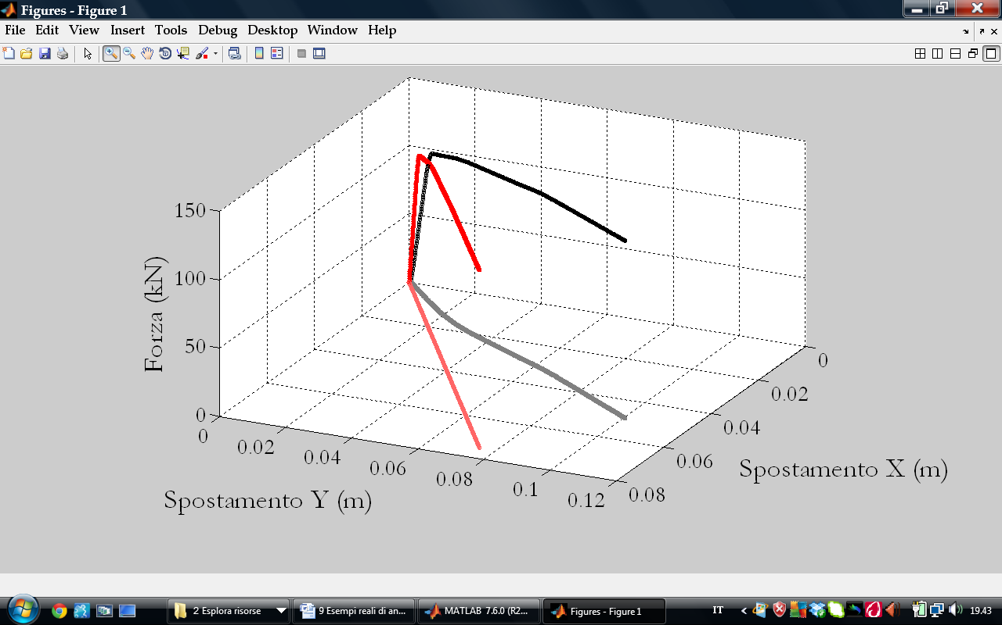
3D-MDOF Systems
Procedures Assessment by means of 3D-MDOF system
Introduction
The Lateral Force used in NLSA has been applied to the system through the use of α-angle parameter
Pushover Analysis
Y
Structural Response
The parameter represented by α-angle allows to compare NLSA and RHA along the α-direction
Seismic Demand
X
α
Non Linear Procedures
α-direction
SDOF
Systems
2D-MDOF Systems
NLSA is performed along generic α-direction that allows to “project” analysis response in Z−α-direction plane
3D-MDOF Systems
Conclusions

Slide 68
3D-MDOF Systems
Procedures Assessment by means of 3D-MDOF system
Introduction
The pushover analyses have been performed for α angle from 0° to 360° (Δα = 45°)
Pushover Analysis
Response of CM (X/Y-displacement) evaluated using by pushover analyses
Structural Response
Seismic Demand
Non Linear Procedures
SDOF
Systems
2D-MDOF Systems
3D-MDOF Systems
Each pushover result can be represented by a point in X-Y plane
Since a number of solutions have been evaluated, the “solution ellipse” can be plotted
Conclusions

Slide 69
3D-MDOF Systems
Procedures Assessment by means of 3D-MDOF system
Introduction
The results obtained from RHA can be represented in a plane using a curve S = S(t)
Pushover Analysis
Y
Mean μ
Structural Response
Y
S_{y}
_{(β)}s_{i} -_{(β)}σ_{i}
A
μ ±σ
S_{y}
_{(β)}s_{i} +_{(β)}σ_{i}
X
Seismic Demand
S_{y}’
_{(α)}S’
β₀
_{(β)}s_{i}
_{(α)}S
β
Non Linear Procedures
α
_{(βo)}S_{i}
S_{x}
SDOF
Systems
S_{x}’
S_{x}
X
S_{i}(t) = [S_{i,x}(t), S_{i,y}(t)]
2D-MDOF Systems
Using the “projection” procedure, for a fixed direction α = β, it is possible to compute the mean and standard deviation values processing results from each of 7 accelerograms
3D-MDOF Systems
Conclusions

Slide 70
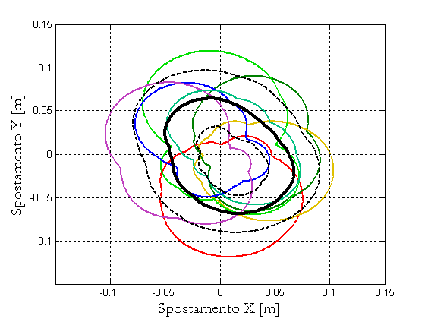
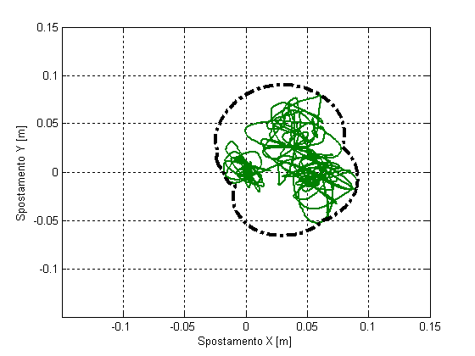
3D-MDOF Systems
Procedures Assessment by means of 3D-MDOF system
Introduction
The procedure of projection is necessary for:
Statistic processing of RHA output
Comparison between NLSAs and RHA results
Pushover Analysis
Structural Response
Seismic Demand
Mean response
Non Linear Procedures
SDOF
Systems
2D-MDOF Systems
3D-MDOF Systems
Conclusions

Slide 71
3D-MDOF Systems
Procedures Assessment by means of 3D-MDOF system
Introduction
Comparison between elastic and inelastic mean responses in terms of base shear
Pushover Analysis
Structural Response
Seismic Demand
Non Linear Procedures
SDOF
Systems
2D-MDOF Systems
3D-MDOF Systems
Conclusions

Slide 72
3D-MDOF Systems
Procedures Assessment by means of 3D-MDOF system
Introduction
Mean response in terms of displacement for elastic behavior
Pushover Analysis
Structural Response
Seismic Demand
Non Linear Procedures
SDOF
Systems
2D-MDOF Systems
3D-MDOF Systems
Conclusions

Slide 73
3D-MDOF Systems
Procedures Assessment by means of 3D-MDOF system
Introduction
Mean response in terms of displacement for inelastic behavior
Pushover Analysis
Structural Response
Seismic Demand
Non Linear Procedures
SDOF
Systems
2D-MDOF Systems
3D-MDOF Systems
Conclusions

Slide 74
3D-MDOF Systems
Procedures Assessment by means of 3D-MDOF system
Introduction
Comparison between elastic and inelastic mean responses (displ.)
Pushover Analysis
Structural Response
Seismic Demand
Non Linear Procedures
SDOF
Systems
2D-MDOF Systems
3D-MDOF Systems
Conclusions

Slide 75
3D-MDOF Systems
Procedures Assessment by means of 3D-MDOF system
Introduction
Ratio of inelastic and elastic mean displacement
Pushover Analysis
Structural Response
Seismic Demand
Non Linear Procedures
SDOF
Systems
2D-MDOF Systems
3D-MDOF Systems
Conclusions

Slide 76
3D-MDOF Systems
Procedures Assessment by means of 3D-MDOF system
Introduction
Comparison between RHA and NLSAs responses (displacement)
Pushover Analysis
EC8-N2
Energy-A
Energy-B
RHA
Structural Response
Seismic Demand
Non Linear Procedures
SDOF
Systems
2D-MDOF Systems
3D-MDOF Systems
Conclusions

Slide 77
3D-MDOF Systems
Procedures Assessment by means of 3D-MDOF system
Introduction
Comparison between Max RHA and NLSAs responses (displac.)
Pushover Analysis
EC8-N2
Energy-A
Energy-B
RHA
Structural Response
Seismic Demand
Non Linear Procedures
SDOF
Systems
2D-MDOF Systems
3D-MDOF Systems
Conclusions

Slide 78
3D-MDOF Systems
Procedures Assessment by means of 3D-MDOF system
Introduction
When a comparison has to performed, it is crucial to compare the NLSA “Ellipse” with the maximum mean response of RHA
Pushover Analysis
Structural Response
Seismic Demand
Non Linear Procedures
SDOF
Systems
Center of Mass
2D-MDOF Systems
3D-MDOF Systems
In this case, the pushover analyses, which provide a better approximation, correspond to α-angle ranging from 270 to 360°
Conclusions

Slide 79
3D-MDOF Systems
Procedures Assessment by means of 3D-MDOF system
Introduction
In terms of displacement, when the mean RHA response is compared to estimated performance provide by NLSAs, the error parameter is reported below for α = 270° and α = 315°
Pushover Analysis
Structural Response
Seismic Demand
Non Linear Procedures
SDOF
Systems
α = 270°
α = 315°
2D-MDOF Systems
As clearly shown by the results expressed by error parameter, when α = 315°, which provides the most accurate estimation, the Energy-based approaches (Energy B in particular) are a robust tool to evaluate non linear response of system
3D-MDOF Systems
Conclusions

Slide 80
Conclusions
Main conclusions
Introduction
Pushover Analysis
Structural Response
Seismic Demand
Non Linear Procedures
SDOF
Systems
2D-MDOF Systems
3D-MDOF Systems
Conclusions
Conclusions

Slide 81
Conclusions
Main conclusions
Introduction
Applying an energy-based concept to NLSA allows to achieve several benefits
Representation of both structural behavior and seismic demand in terms of (pseudo) energy
Introduction of same-energy displacement which avoids the arbitrary selection of a control point (usually rooftop CM)
Energy-based procedures provide a robust and accurate estimation of “conventional exact” seismic response (RHA)
Evaluations result be more accurate when they are express in terms of displacement and storey drift rather than base shear
Pushover Analysis
Structural Response
Seismic Demand
Non Linear Procedures
SDOF
Systems
2D-MDOF Systems
3D-MDOF Systems
Conclusions

Slide 82
Conclusions
Main conclusions
Introduction
Encouraging and comforting results have been found for all SDOF, 2D-MDOF and 3D-MDOF systems
A preliminary energy-based approach has been introduced for 3D-MDOF structures, remaining several crucial aspects which require to be investigated
Both energy-based NL procedures (En-A, En-B) can be directly applied to practical purposes
Pushover Analysis
Structural Response
Seismic Demand
Non Linear Procedures
SDOF
Systems
2D-MDOF Systems
3D-MDOF Systems
Conclusions

Slide 83
Università degli Studi di Perugia
Facoltà di Ingegneria
Dottorato in Ingegneria Civile e Materiali Innovativi
XXV Ciclo – ICAR 09
Anno Accademico 2011/2012
Approccio Energetico per la Valutazione
della Risposta Sismica delle Strutture
Mediante la Analisi Statica Non Lineare
Candidato:
dott. ing. Enrico Tomassoli
Relatore:
prof. Marco Mezzi
Coordinatore:
prof. Claudio Tamagnini

